Slide 1



MARVEL SUPERHEROES
Presentation by 梁廣廷
資料視覺化 | 2023 FALL
Tamkang University

Slide 2
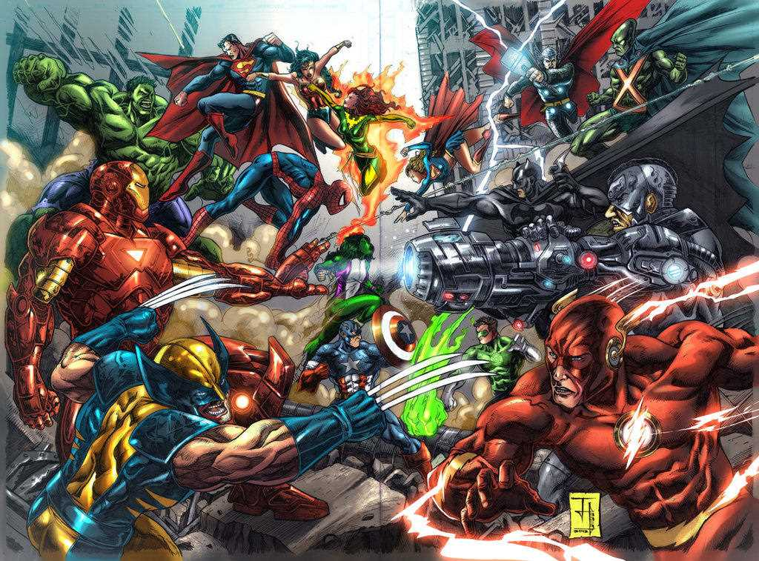
INTRODUCTION
Presentation by 梁廣廷 | 資料視覺化 | 2023 FALL | Tamkang University

Slide 3
OUTLINE
SHOW THE DATASET NAME AND SOURCE
COLUMN NAMES DESCRIPTIONS AND RECORDS
YOUR QUESTIONS AND CORRESPONDING ANALYSIS PLOTS
CONCLUSIONS
Presentation by 梁廣廷 | 資料視覺化 | 2023 FALL | Tamkang University

Slide 4
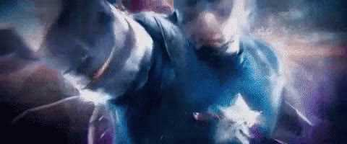


DATASET NAME
AND SOURCE ADDRESS
https://www.kaggle.com/datasets/dannielr/marvel-superheroes
Marvel Superheroes
Presentation by 梁廣廷 | 資料視覺化 | 2023 FALL | Tamkang University

Slide 5
LIBRARY
streamlit
pandas
matplotlib
seaborn
plotly
pre-commit
ruff
Presentation by 梁廣廷 | 資料視覺化 | 2023 FALL | Tamkang University

Slide 6
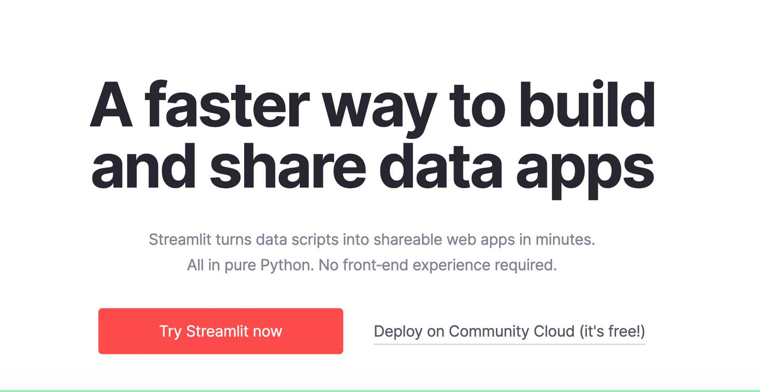
STREAMLIT
Presentation by 梁廣廷 | 資料視覺化 | 2023 FALL | Tamkang University

Slide 7

Presentation by 梁廣廷 | 資料視覺化 | 2023 FALL | Tamkang University

Slide 8
QUESTIONS
FIRST APPEARANCE
ABILITIES & POWERS
IDENTITY DISTRUBUTION
TOTAL POWER OF THE TEAM BY CHARACTERS
GENDER VS. ALIGNMENT
COMPARISON OF CHARACTERS
IDENTITY VS. ALIGNMENT
Presentation by 梁廣廷 | 資料視覺化 | 2023 FALL | Tamkang University

Slide 9
TABLEAU PUBLIC LINK
link
Presentation by 梁廣廷 | 資料視覺化 | 2023 FALL | Tamkang University

Slide 10
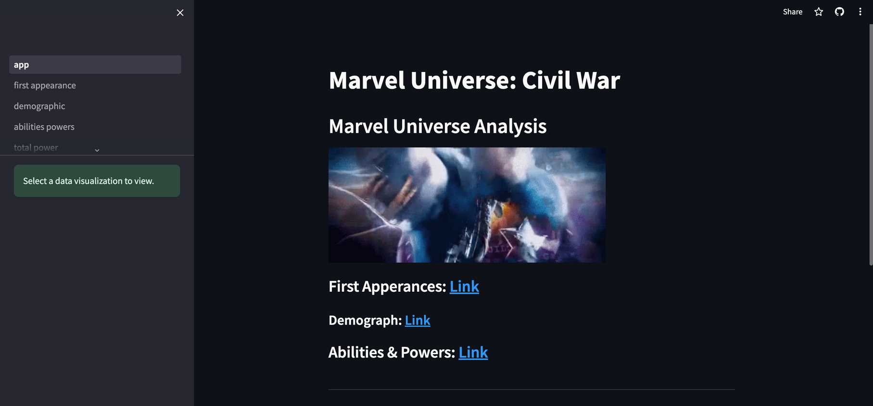
DEMO
LINK
Presentation by 梁廣廷 | 資料視覺化 | 2023 FALL | Tamkang University

Slide 11
MARVEL UNIVERSE ANALYSIS
Presentation by 梁廣廷 | 資料視覺化 | 2023 FALL | Tamkang University

Slide 12
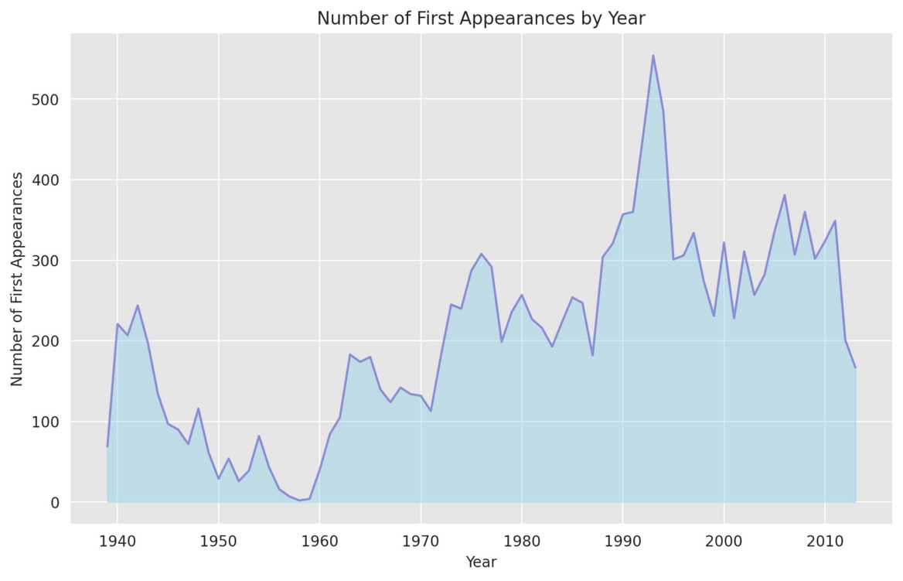
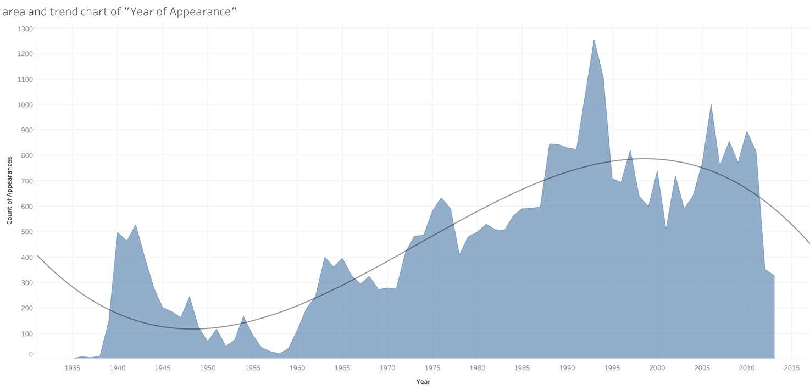
Presentation by 梁廣廷 | 資料視覺化 | 2023 FALL | Tamkang University

Slide 13
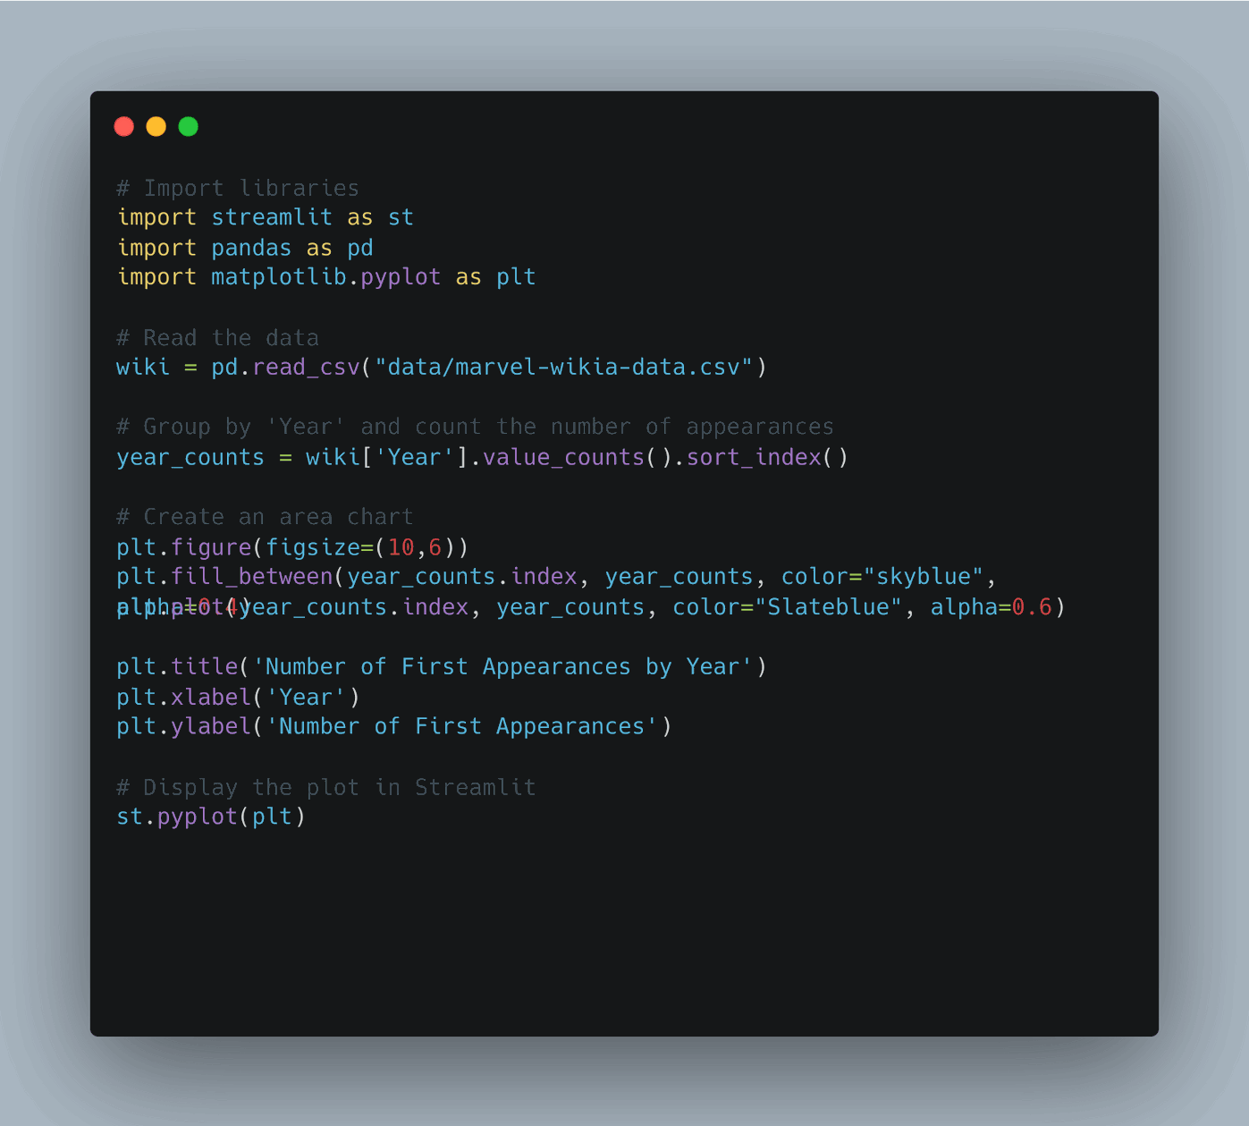

Slide 14
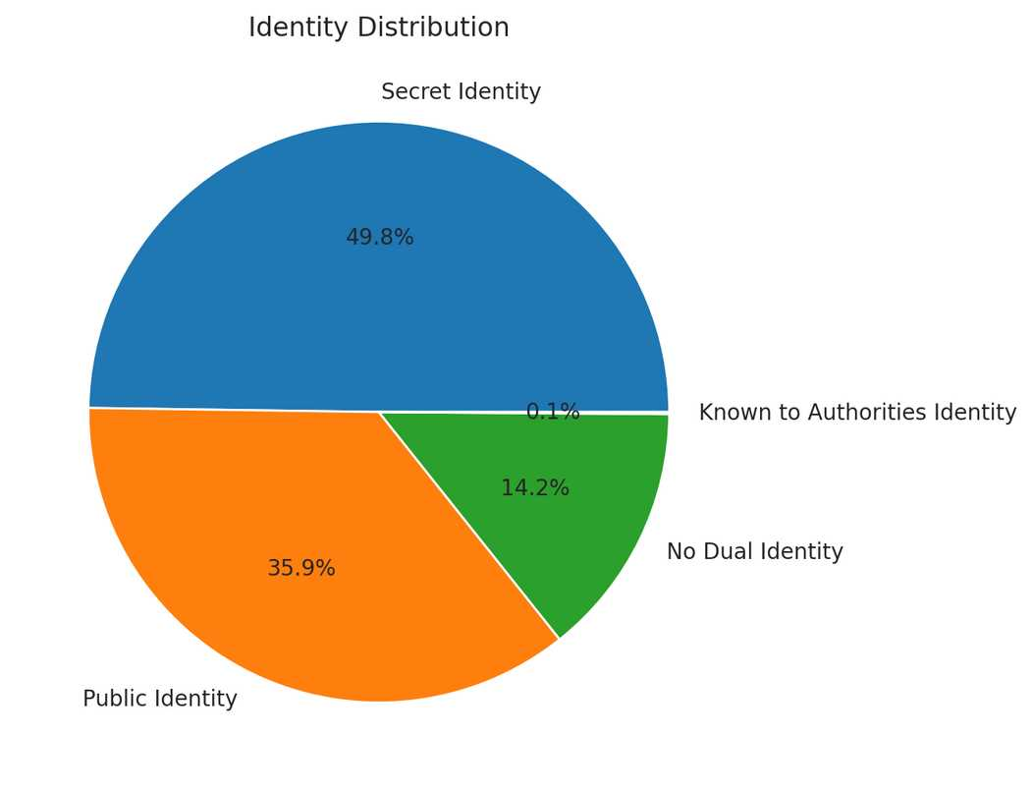
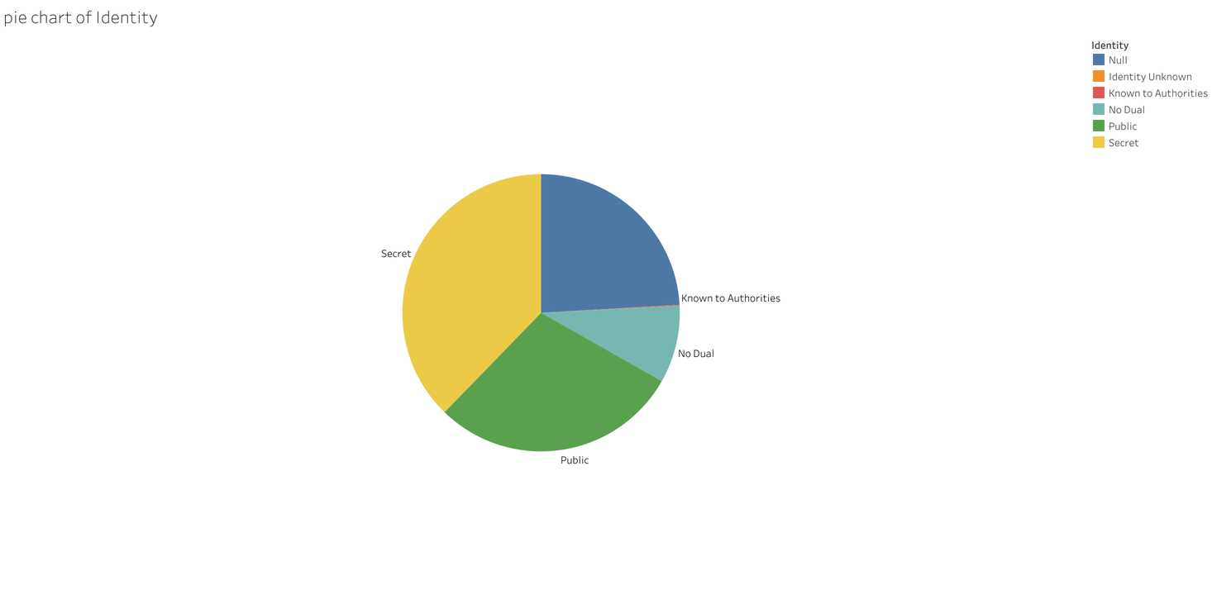
Presentation by 梁廣廷 | 資料視覺化 | 2023 FALL | Tamkang University

Slide 15
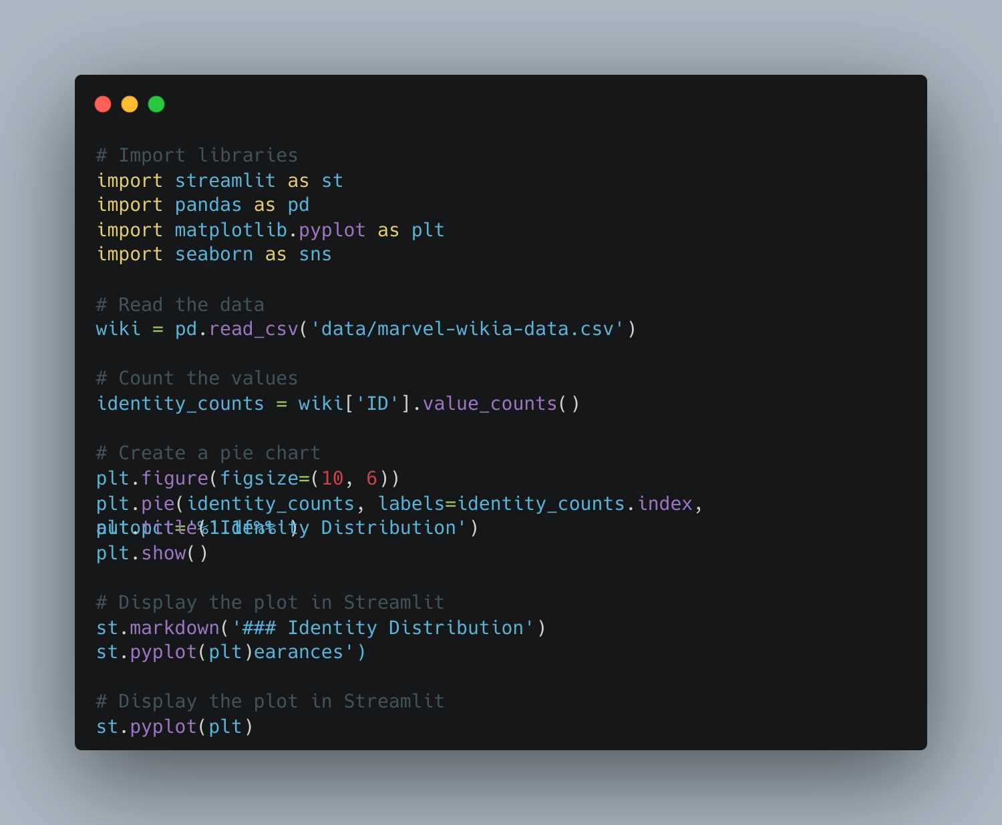

Slide 16
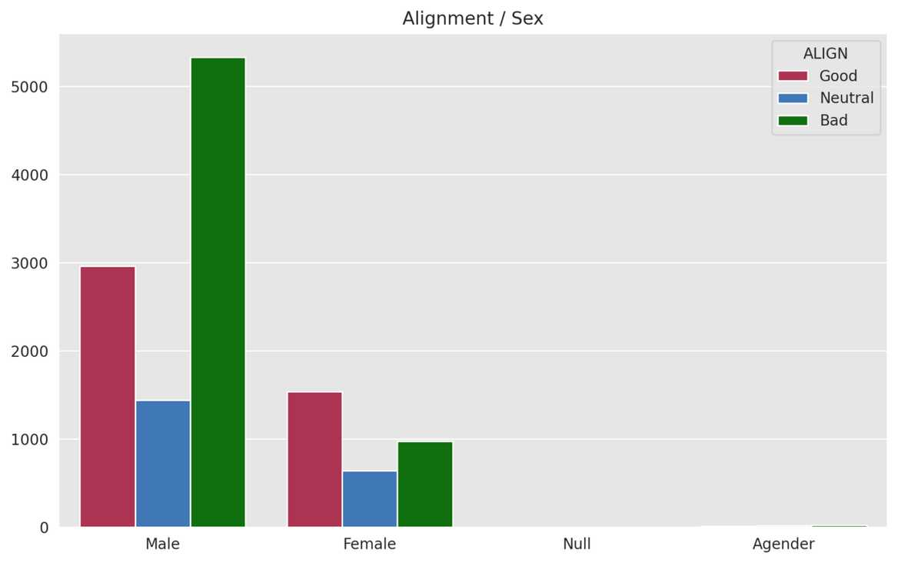
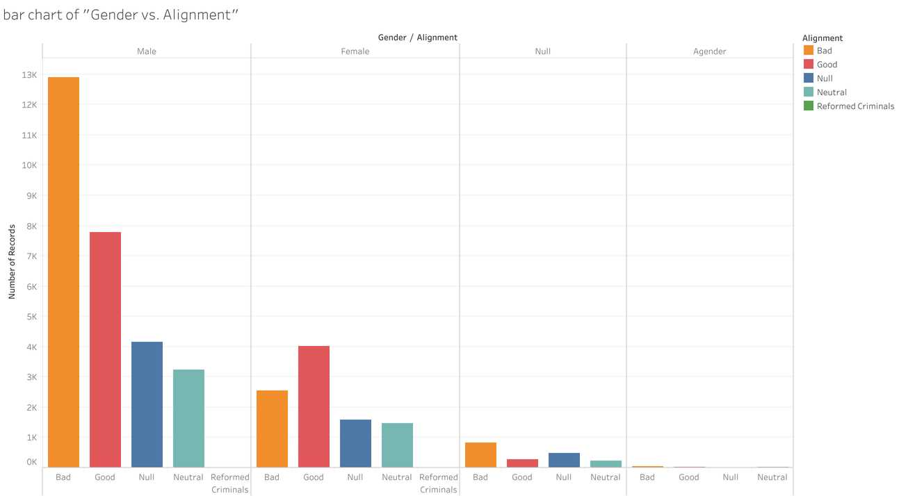
Presentation by 梁廣廷 | 資料視覺化 | 2023 FALL | Tamkang University

Slide 17
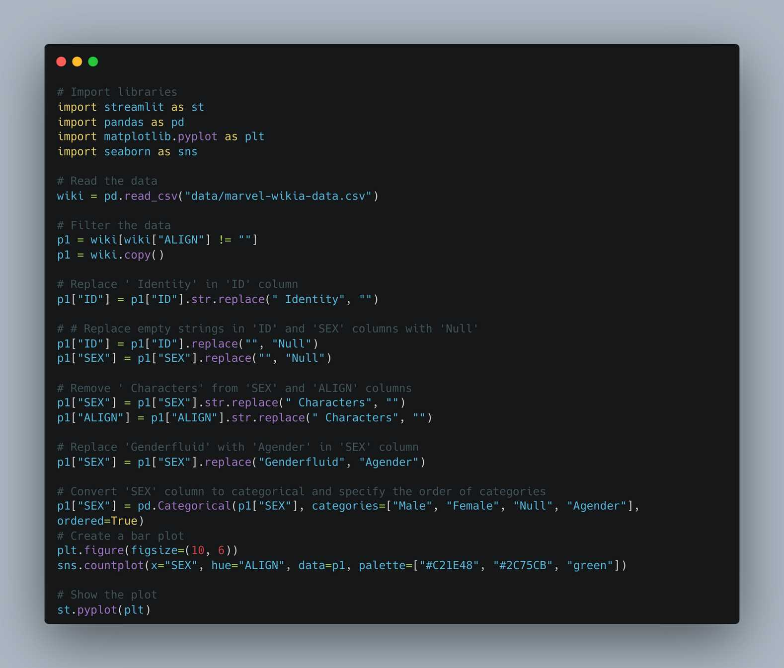

Slide 18
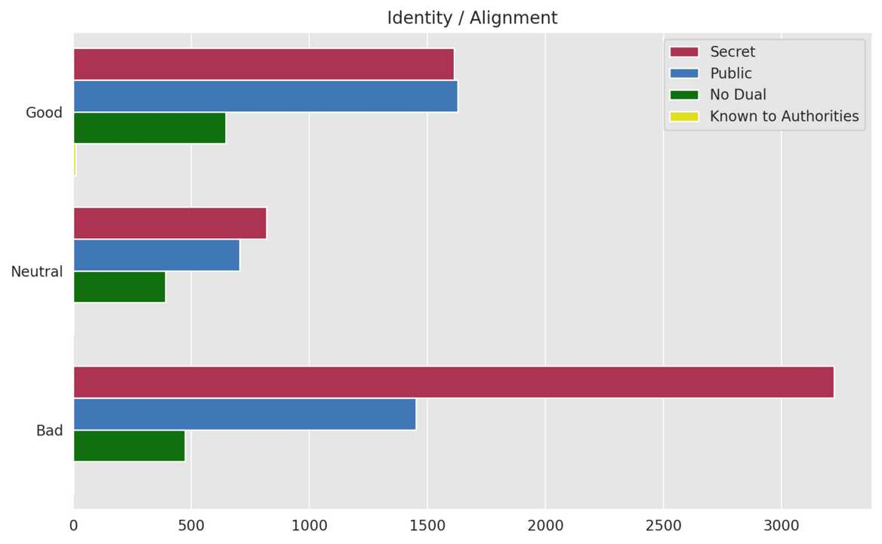
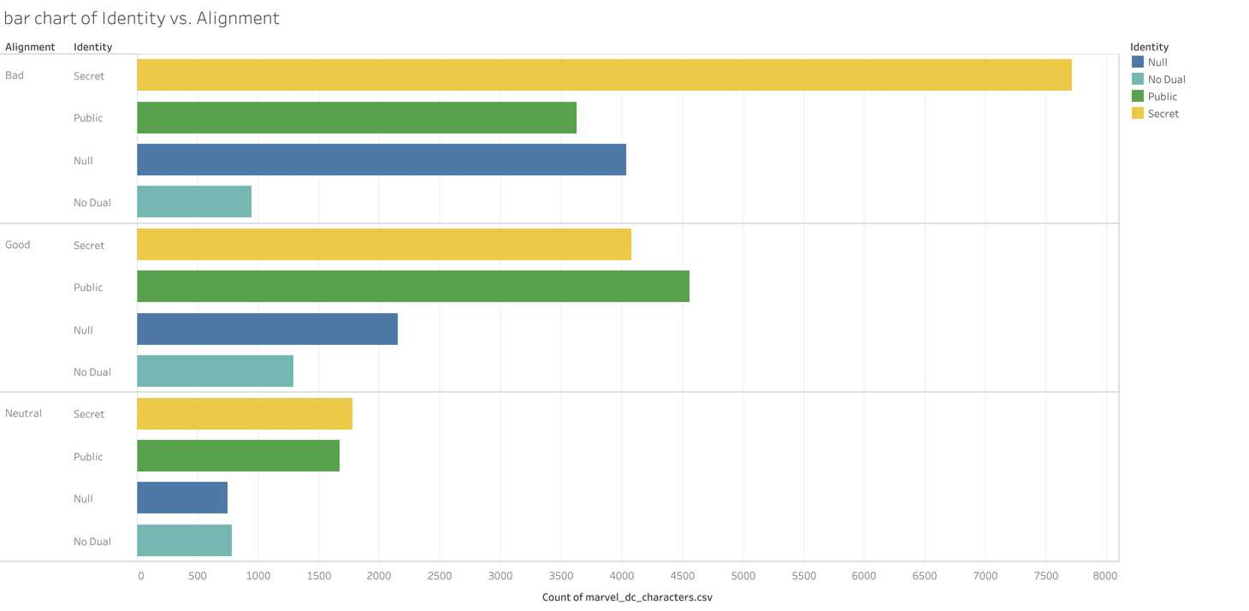
Presentation by 梁廣廷 | 資料視覺化 | 2023 FALL | Tamkang University

Slide 19
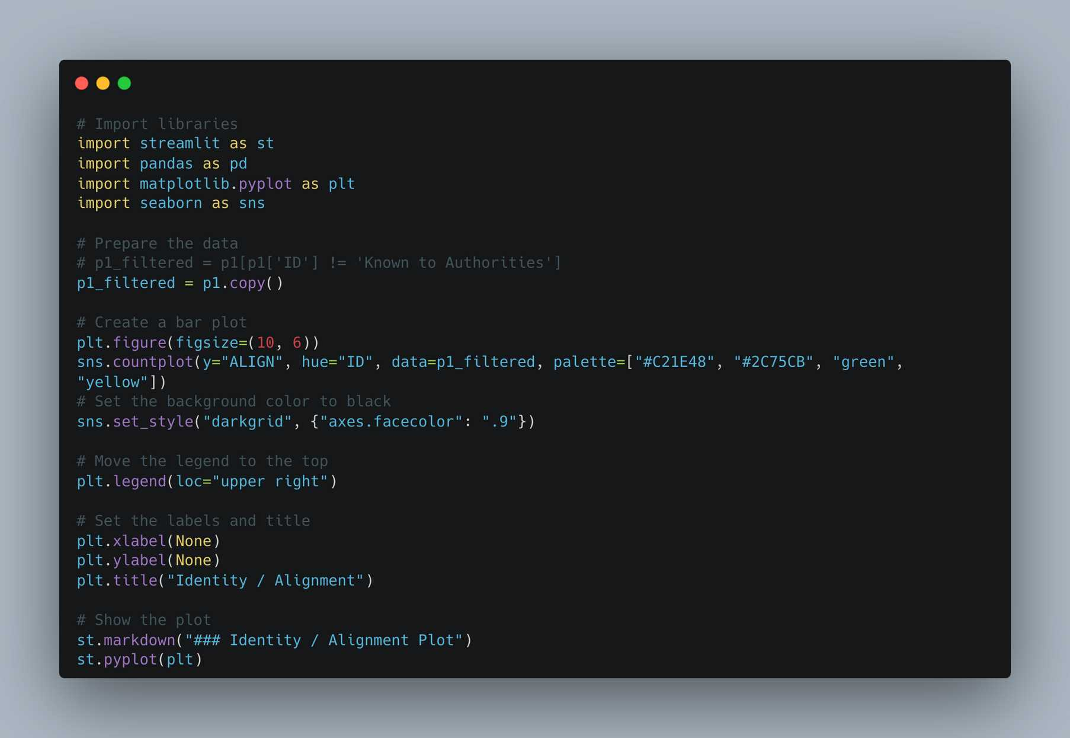

Slide 20
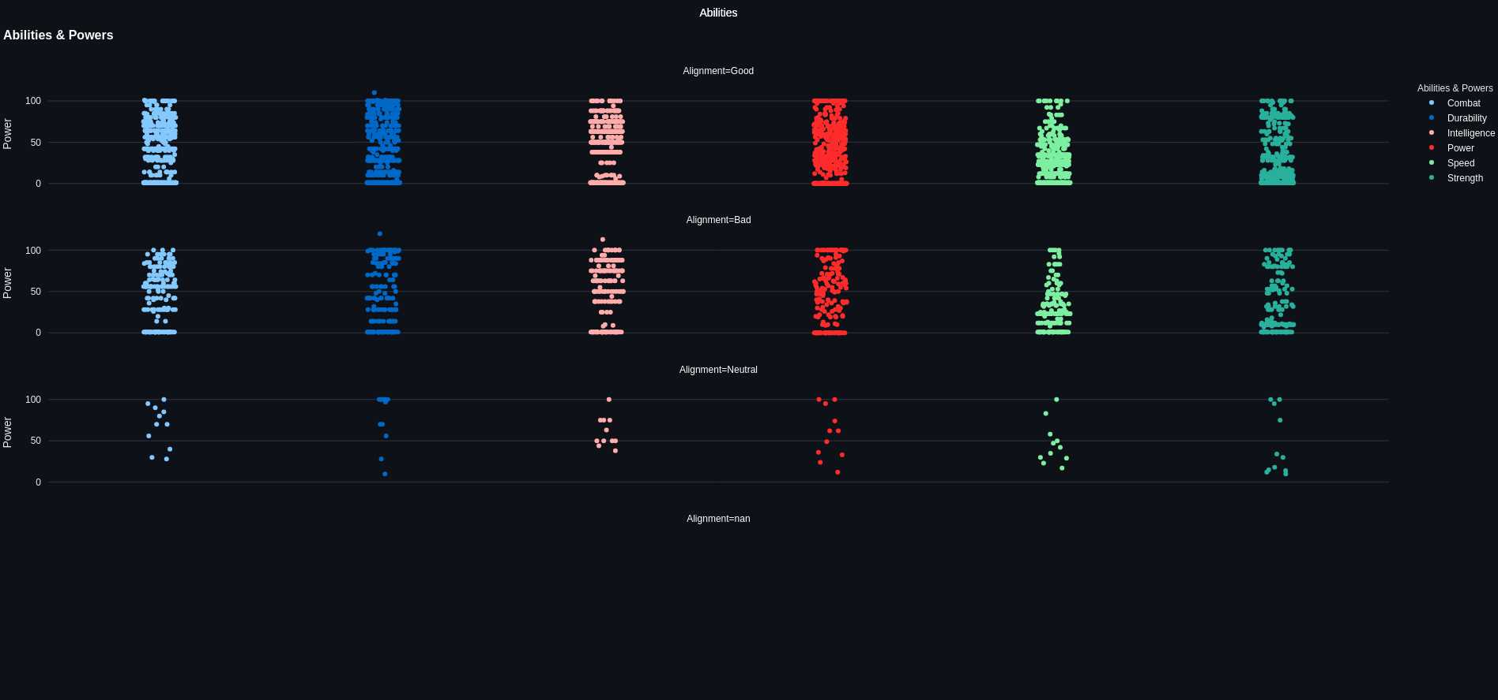

Slide 21
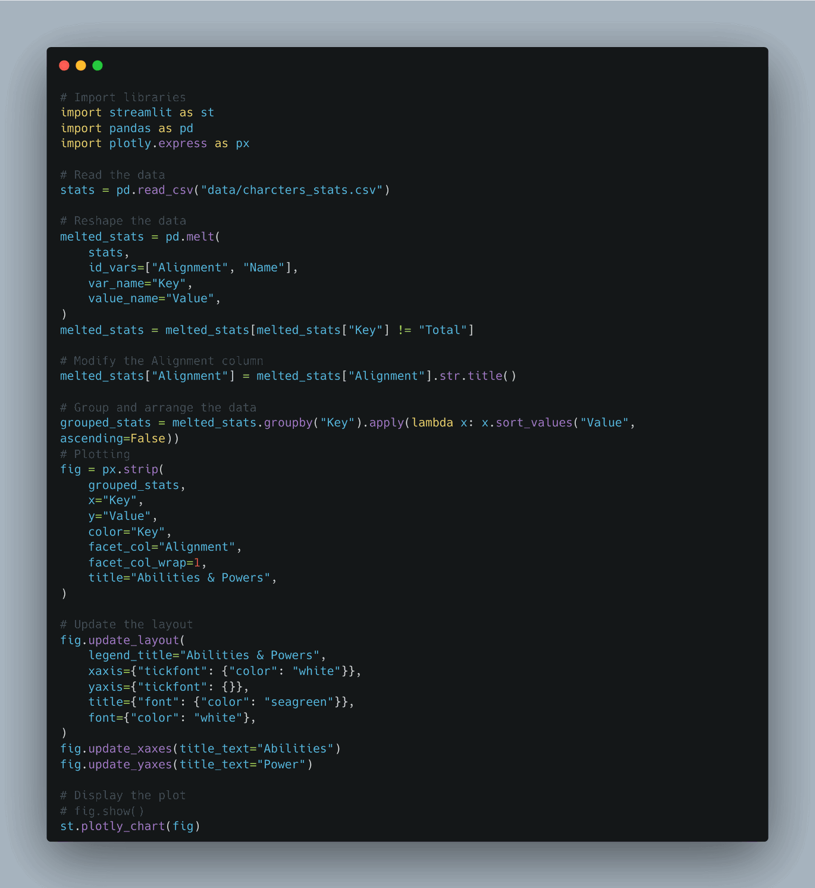

Slide 22
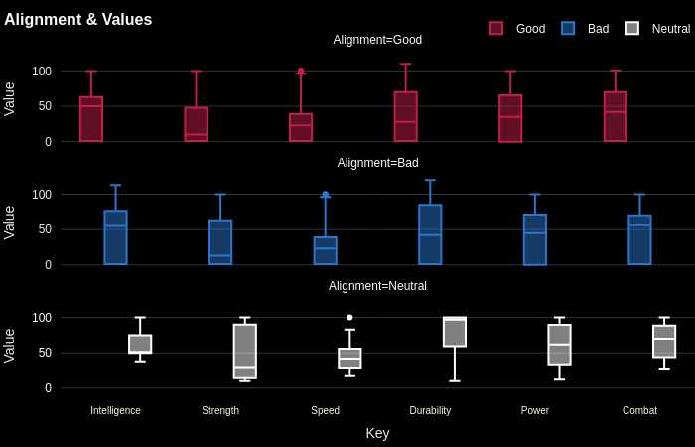
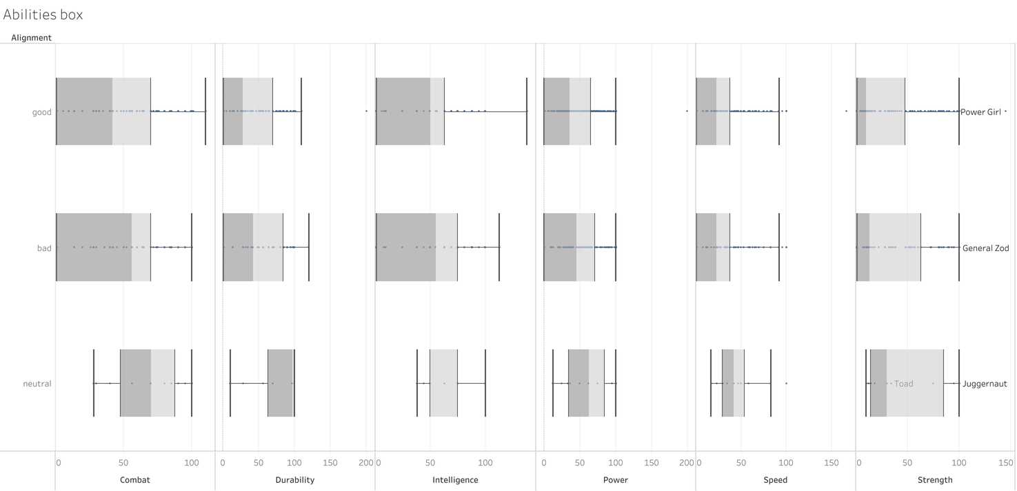
Presentation by 梁廣廷 | 資料視覺化 | 2023 FALL | Tamkang University

Slide 23
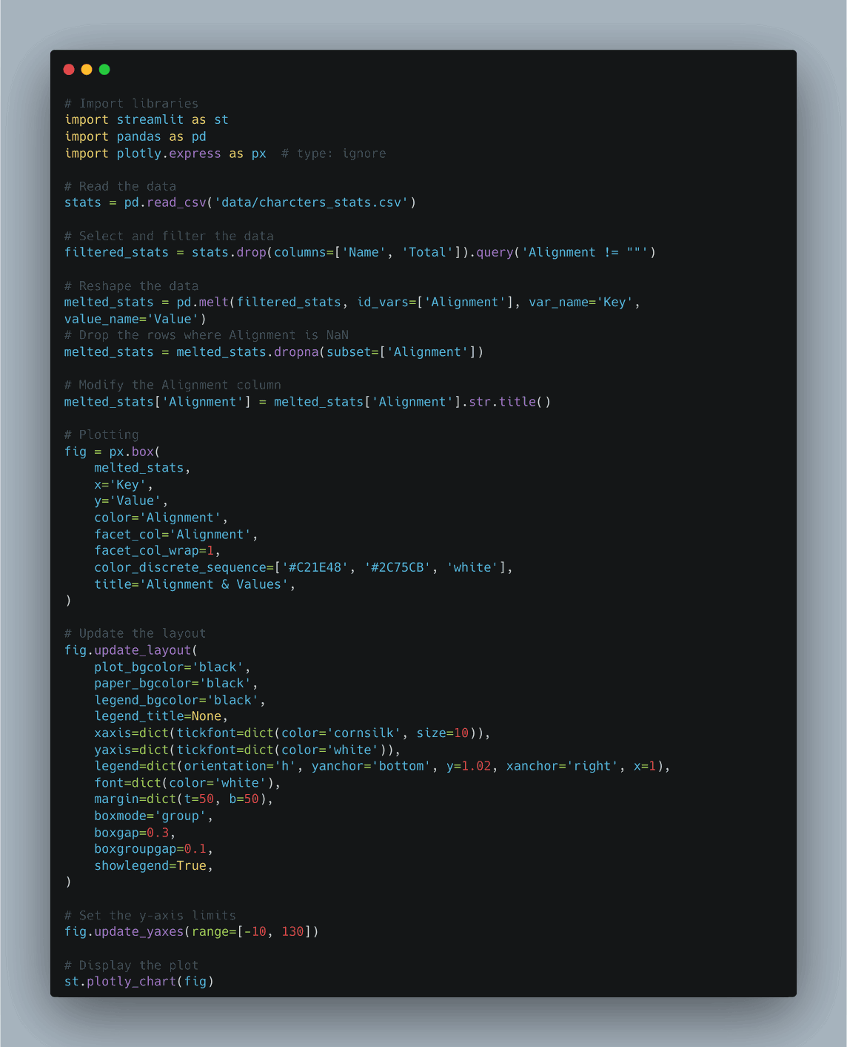

Slide 24
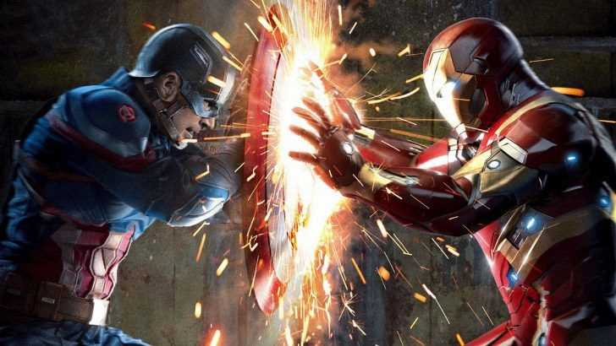
CIVIL WAR ANALYSIS
Team Cap vs Team Iron Man
Presentation by 梁廣廷 | 資料視覺化 | 2023 FALL | Tamkang University

Slide 25
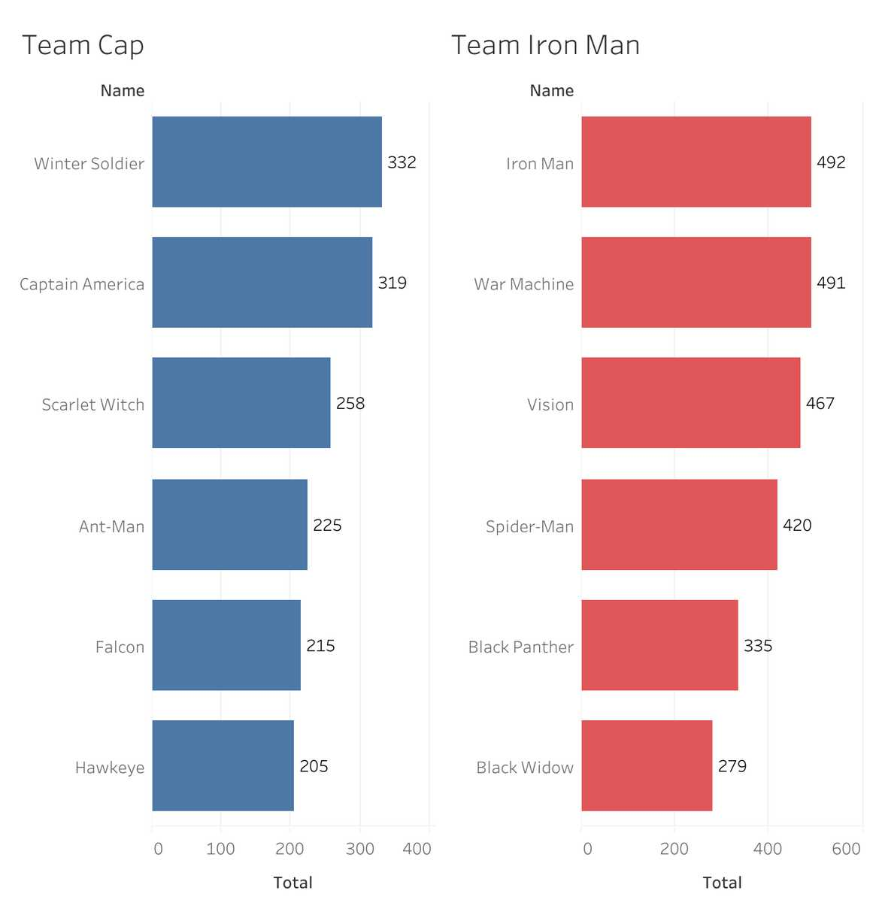
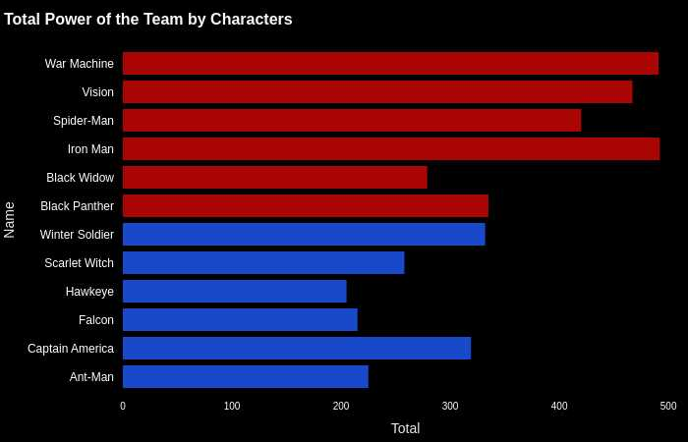

Slide 26
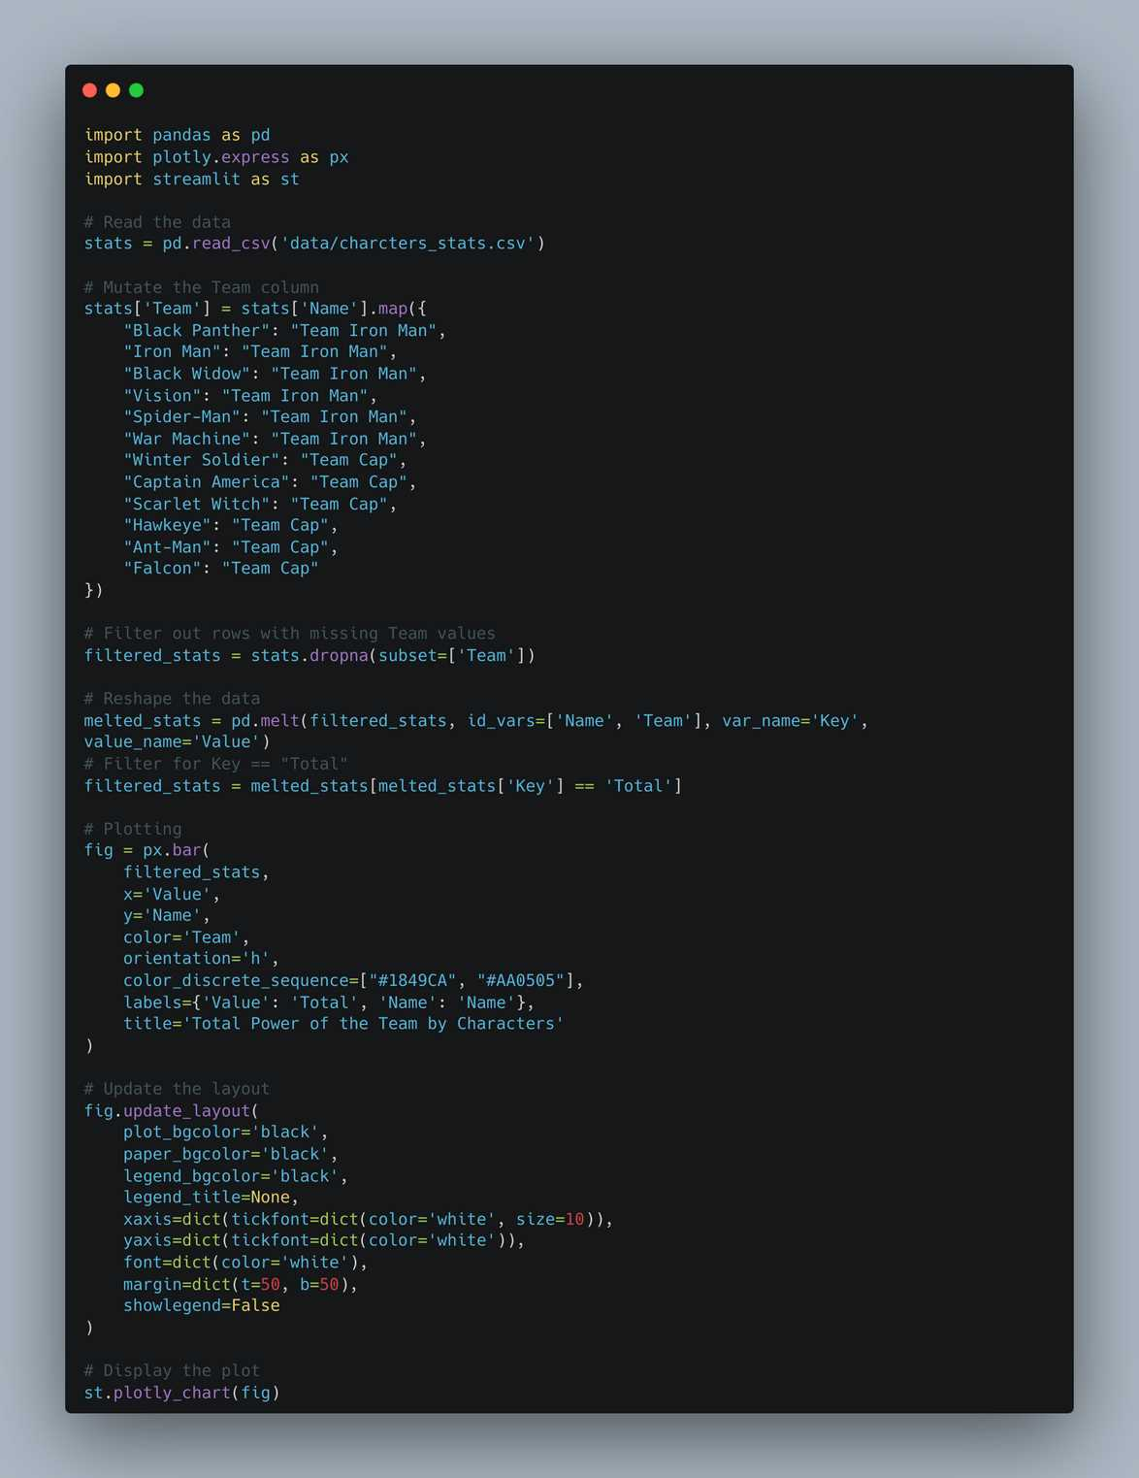

Slide 27
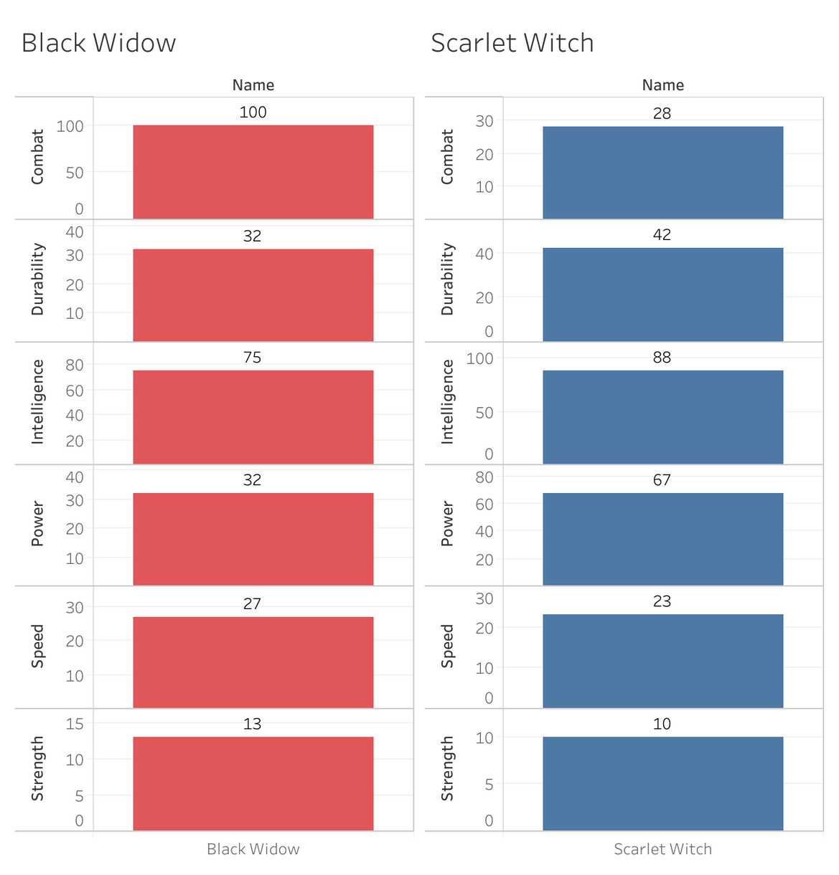
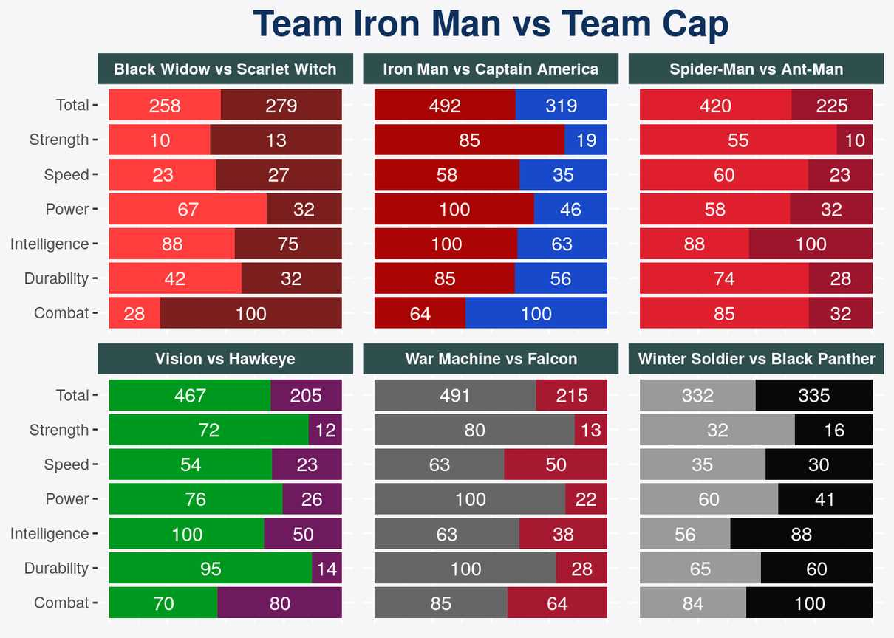

Slide 28
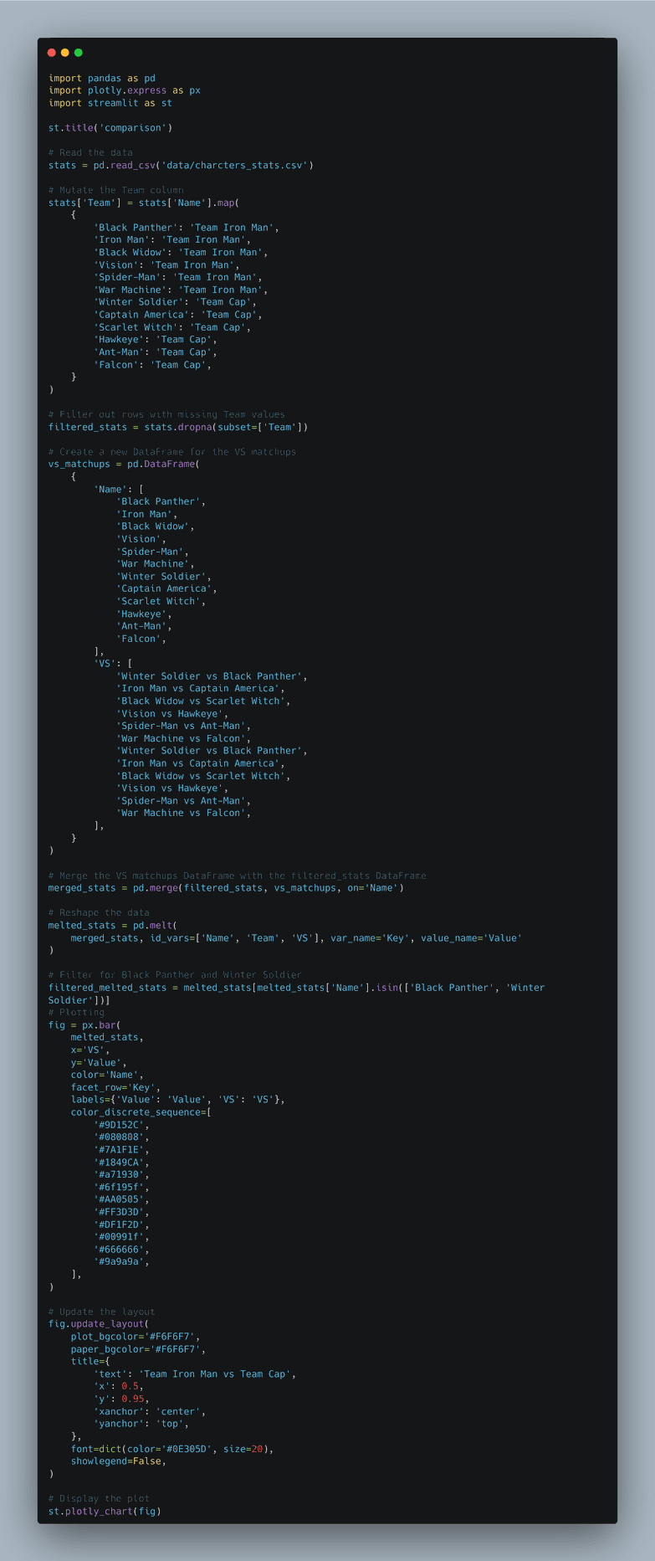

Slide 29
REFERENCES
STREAMLIT FOR DATA SCIENCE:
CREATE INTERACTIVE DATA APPS IN PYTHON
DOCS.STREAMLIT.IO/
HARNESSING GITHUB COPILOT WITH PYTHON
Presentation by 梁廣廷 | 資料視覺化 | 2023 FALL | Tamkang University

Slide 30
THANK YOU
Presentation by 梁廣廷
資料視覺化 | 2023 FALL
Tamkang University

